Slide 1
Chinese Remainder Theorem Lesson 2
INSERT
VIDEO
HERE

Slide 2
Chinese Remainder Theorem Lesson 2
Restrictions on choice of moduli
INSERT
VIDEO
HERE

Slide 3
Chinese Remainder Theorem Lesson 2
Restrictions on choice of moduli
Converting from CRT to an integer
INSERT
VIDEO
HERE

Slide 4
Chinese Remainder Theorem Lesson 2
Restrictions on choice of moduli
Converting from CRT to an integer
Next lesson
INSERT
VIDEO
HERE

Slide 5
Chinese Remainder Theorem Lesson 2
Restrictions on choice of moduli
Converting from CRT to an integer
Next lesson
What we can do with CRT
INSERT
VIDEO
HERE

Slide 6
Chinese Remainder Theorem Lesson 2
Restrictions on choice of moduli
Converting from CRT to an integer
Next lesson
What we can do with CRT
What we can’t do with CRT
INSERT
VIDEO
HERE

Slide 7
CRT moduli must be pairwise coprime
INSERT
VIDEO
HERE

Slide 8

CRT moduli must be pairwise coprime
$\text{Can} \text{we} \text{choose} \text{arbitrary} \text{moduli} \text{for} \text{CRT}$?
INSERT
VIDEO
HERE

Slide 9
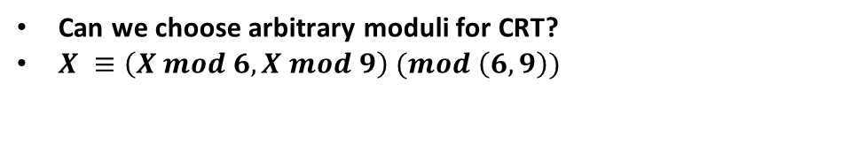
CRT moduli must be pairwise coprime
$\text{Can} \text{we} \text{choose} \text{arbitrary} \text{moduli} \text{for} \text{CRT}$?
$X ≡\left(X mod 6, X mod 9\right) (mod \left(6,9\right))$
INSERT
VIDEO
HERE

Slide 10
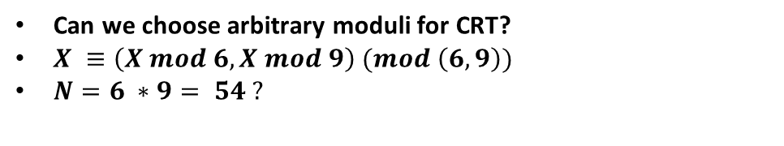
CRT moduli must be pairwise coprime
$\text{Can} \text{we} \text{choose} \text{arbitrary} \text{moduli} \text{for} \text{CRT}$?
$X ≡\left(X mod 6, X mod 9\right) (mod \left(6,9\right))$
$N=6 ∗9= 54 ?$
INSERT
VIDEO
HERE

Slide 11
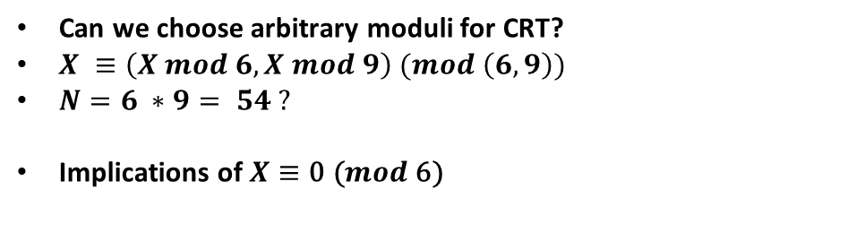
CRT moduli must be pairwise coprime
$\text{Can} \text{we} \text{choose} \text{arbitrary} \text{moduli} \text{for} \text{CRT}$?
$X ≡\left(X mod 6, X mod 9\right) (mod \left(6,9\right))$
$N=6 ∗9= 54 ?$
$\text{Implications} \text{of} X≡\text{0 (}mod\text{ 6)}$
INSERT
VIDEO
HERE

Slide 12
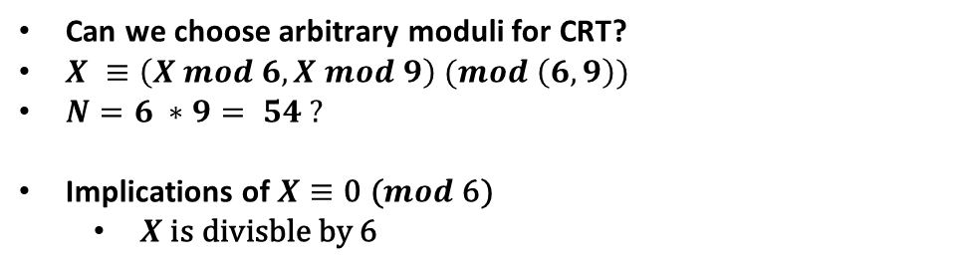
CRT moduli must be pairwise coprime
$\text{Can} \text{we} \text{choose} \text{arbitrary} \text{moduli} \text{for} \text{CRT}$?
$X ≡\left(X mod 6, X mod 9\right) (mod \left(6,9\right))$
$N=6 ∗9= 54 ?$
$\text{Implications} \text{of} X≡\text{0 (}mod\text{ 6)}$
$X \text{is} \text{divisble} \text{by}\text{ 6}$
INSERT
VIDEO
HERE

Slide 13
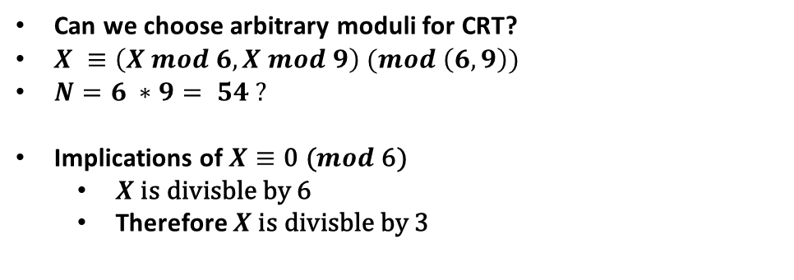
CRT moduli must be pairwise coprime
$\text{Can} \text{we} \text{choose} \text{arbitrary} \text{moduli} \text{for} \text{CRT}$?
$X ≡\left(X mod 6, X mod 9\right) (mod \left(6,9\right))$
$N=6 ∗9= 54 ?$
$\text{Implications} \text{of} X≡\text{0 (}mod\text{ 6)}$
$X \text{is} \text{divisble} \text{by}\text{ 6}$
Therefore $X \text{is} \text{divisble} \text{by}$3
INSERT
VIDEO
HERE

Slide 14
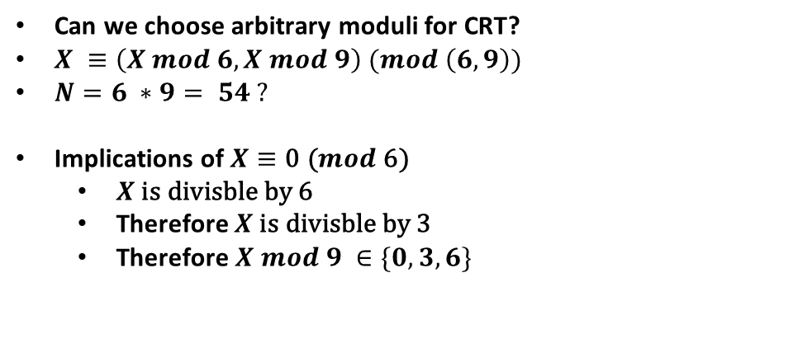
CRT moduli must be pairwise coprime
$\text{Can} \text{we} \text{choose} \text{arbitrary} \text{moduli} \text{for} \text{CRT}$?
$X ≡\left(X mod 6, X mod 9\right) (mod \left(6,9\right))$
$N=6 ∗9= 54 ?$
$\text{Implications} \text{of} X≡\text{0 (}mod\text{ 6)}$
$X \text{is} \text{divisble} \text{by}\text{ 6}$
Therefore $X \text{is} \text{divisble} \text{by}$3
$\text{Therefore} X mod 9 ∈\{0,3,6\}$
INSERT
VIDEO
HERE

Slide 15
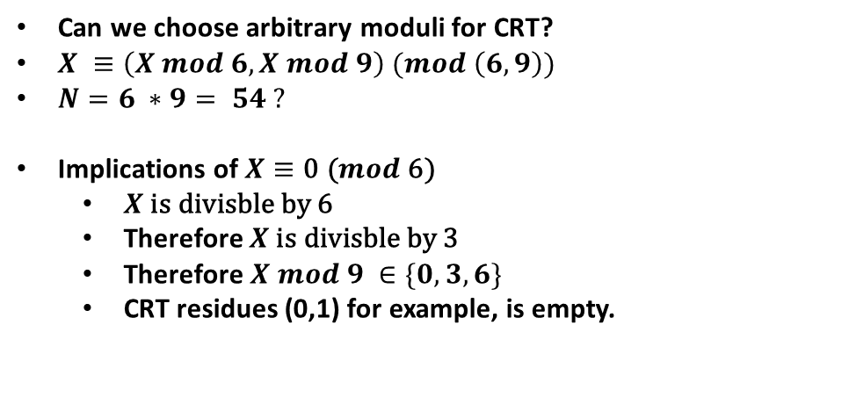
CRT moduli must be pairwise coprime
$\text{Can} \text{we} \text{choose} \text{arbitrary} \text{moduli} \text{for} \text{CRT}$?
$X ≡\left(X mod 6, X mod 9\right) (mod \left(6,9\right))$
$N=6 ∗9= 54 ?$
$\text{Implications} \text{of} X≡\text{0 (}mod\text{ 6)}$
$X \text{is} \text{divisble} \text{by}\text{ 6}$
Therefore $X \text{is} \text{divisble} \text{by}$3
$\text{Therefore} X mod 9 ∈\{0,3,6\}$
CRT residues (0,1) for example, is empty.
INSERT
VIDEO
HERE

Slide 16
CRT moduli must be pairwise coprime
$\text{Can} \text{we} \text{choose} \text{arbitrary} \text{moduli} \text{for} \text{CRT}$?
$X ≡\left(X mod 6, X mod 9\right) (mod \left(6,9\right))$
$N=6 ∗9= 54 ?$
INSERT
VIDEO
HERE

Slide 17
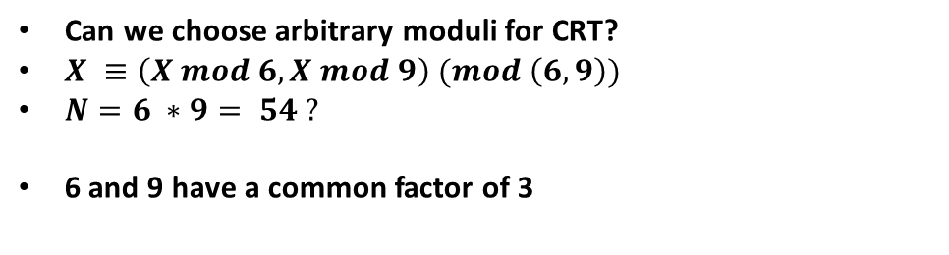
CRT moduli must be pairwise coprime
$\text{Can} \text{we} \text{choose} \text{arbitrary} \text{moduli} \text{for} \text{CRT}$?
$X ≡\left(X mod 6, X mod 9\right) (mod \left(6,9\right))$
$N=6 ∗9= 54 ?$
6 and 9 have a common factor of 3
INSERT
VIDEO
HERE

Slide 18
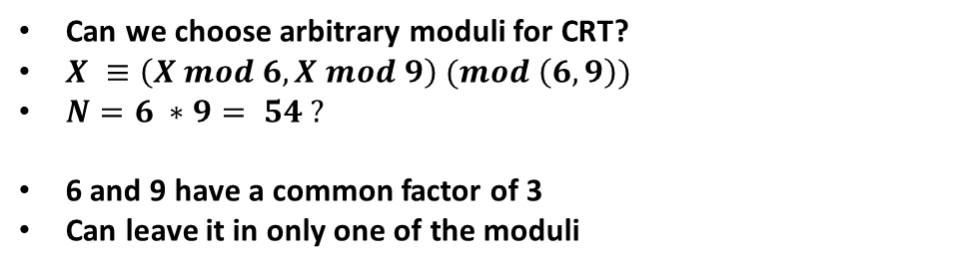
CRT moduli must be pairwise coprime
$\text{Can} \text{we} \text{choose} \text{arbitrary} \text{moduli} \text{for} \text{CRT}$?
$X ≡\left(X mod 6, X mod 9\right) (mod \left(6,9\right))$
$N=6 ∗9= 54 ?$
6 and 9 have a common factor of 3
Can leave it in only one of the moduli
INSERT
VIDEO
HERE

Slide 19
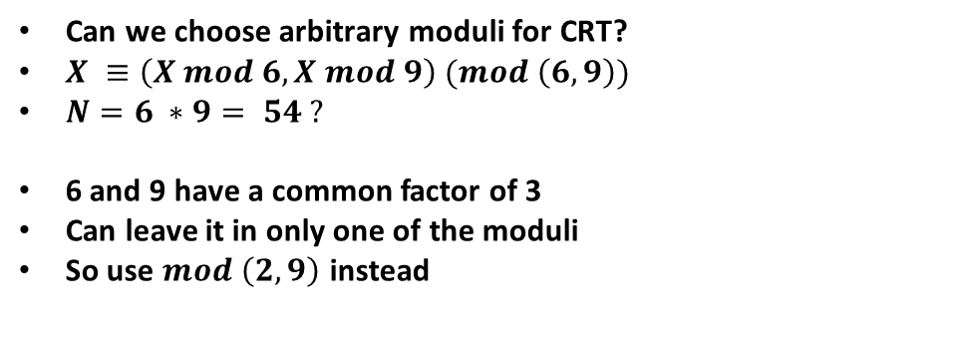
CRT moduli must be pairwise coprime
$\text{Can} \text{we} \text{choose} \text{arbitrary} \text{moduli} \text{for} \text{CRT}$?
$X ≡\left(X mod 6, X mod 9\right) (mod \left(6,9\right))$
$N=6 ∗9= 54 ?$
6 and 9 have a common factor of 3
Can leave it in only one of the moduli
So use $mod \left(2,9\right)$ instead
INSERT
VIDEO
HERE

Slide 20
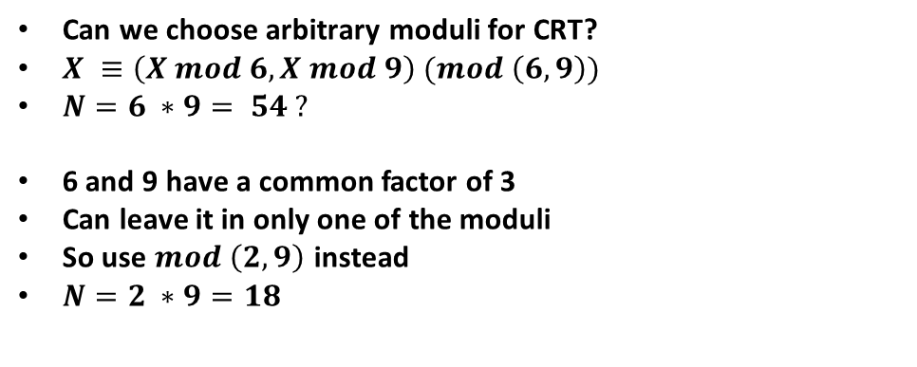
CRT moduli must be pairwise coprime
$\text{Can} \text{we} \text{choose} \text{arbitrary} \text{moduli} \text{for} \text{CRT}$?
$X ≡\left(X mod 6, X mod 9\right) (mod \left(6,9\right))$
$N=6 ∗9= 54 ?$
6 and 9 have a common factor of 3
Can leave it in only one of the moduli
So use $mod \left(2,9\right)$ instead
$N=2 ∗9=18$
INSERT
VIDEO
HERE

Slide 21
Converting from CRT to an integer uses modular arithmetic properties
INSERT
VIDEO
HERE

Slide 22
Converting from CRT to an integer uses modular arithmetic properties
$X≡\left(R1,R2\right) (mod \left(M1,M2\right))$
INSERT
VIDEO
HERE

Slide 23
Converting from CRT to an integer uses modular arithmetic properties
$X≡\left(R1,R2\right) (mod \left(M1,M2\right))$
$N=M1M2$
INSERT
VIDEO
HERE

Slide 24
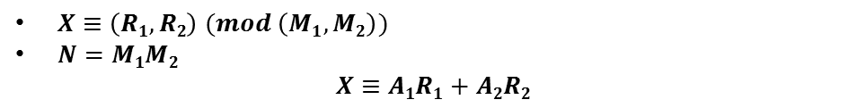
Converting from CRT to an integer uses modular arithmetic properties
$X≡\left(R1,R2\right) (mod \left(M1,M2\right))$
$N=M1M2$
$$X≡A1R1+A2R2$$
INSERT
VIDEO
HERE

Slide 25
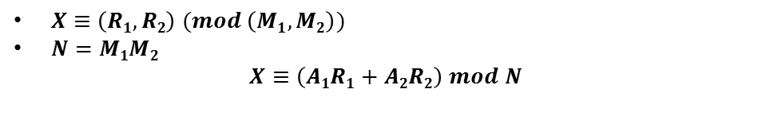
Converting from CRT to an integer uses modular arithmetic properties
$X≡\left(R1,R2\right) (mod \left(M1,M2\right))$
$N=M1M2$
$$X≡\left(A1R1+A2R2\right) mod N$$
INSERT
VIDEO
HERE

Slide 26
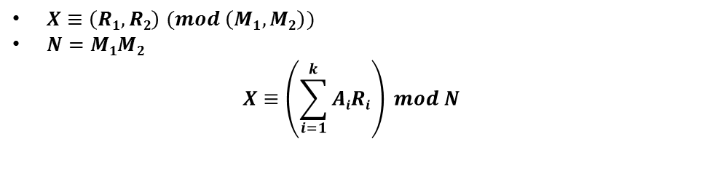
Converting from CRT to an integer uses modular arithmetic properties
$X≡\left(R1,R2\right) (mod \left(M1,M2\right))$
$N=M1M2$
$$X≡\left(\sum_{i=1}^{k}{AiRi}\right) mod N$$
INSERT
VIDEO
HERE

Slide 27

Converting from CRT to an integer uses modular arithmetic properties
$X≡\left(R1,R2\right) (mod \left(M1,M2\right))$
$N=M1M2$
$$X≡\left(\sum_{i=1}^{k}{AiRi}\right) mod N$$
$$N=\prod_{i=1}^{k}{M_{i}}$$
INSERT
VIDEO
HERE

Slide 28

Converting from CRT to an integer uses modular arithmetic properties
$X≡\left(R1,R2\right) (mod \left(M1,M2\right))$
$N=M1M2$
$$X≡\left(\sum_{i=1}^{k}{AiRi}\right) mod N$$
$$N=\prod_{i=1}^{k}{M_{i}}$$
$Ai≡0 \left(mod Mj\right) for all i≠j$
INSERT
VIDEO
HERE

Slide 29
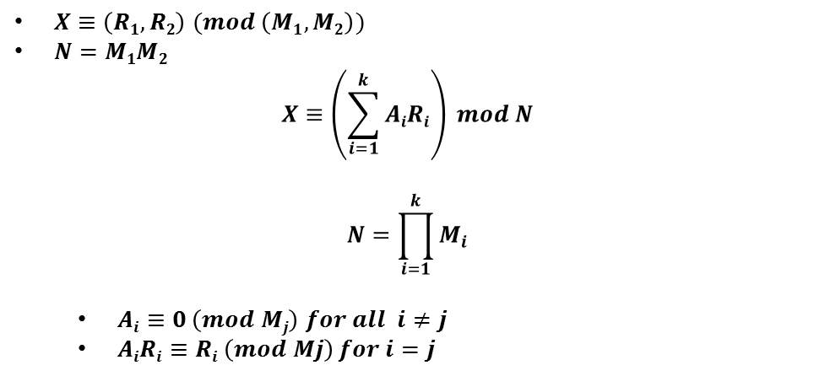
Converting from CRT to an integer uses modular arithmetic properties
$X≡\left(R1,R2\right) (mod \left(M1,M2\right))$
$N=M1M2$
$$X≡\left(\sum_{i=1}^{k}{AiRi}\right) mod N$$
$$N=\prod_{i=1}^{k}{M_{i}}$$
$Ai≡0 \left(mod Mj\right) for all i≠j$
$AiRi≡Ri \left(mod Mj\right) for i=j$
INSERT
VIDEO
HERE

Slide 30
Make terms vanish for other moduli by multiplying by all other moduli
INSERT
VIDEO
HERE

Slide 31
Make terms vanish for other moduli by multiplying by all other moduli
$M_{i}·b≡\text{0 (}mod M_{i}\text{) }\text{for} \text{all} \text{b}$
INSERT
VIDEO
HERE

Slide 32
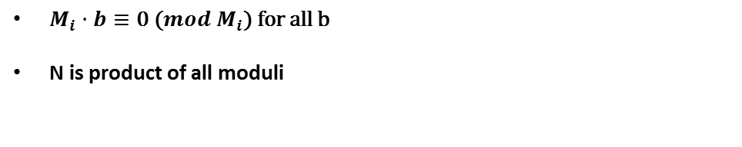
Make terms vanish for other moduli by multiplying by all other moduli
$M_{i}·b≡\text{0 (}mod M_{i}\text{) }\text{for} \text{all} \text{b}$
N is product of all moduli
INSERT
VIDEO
HERE

Slide 33
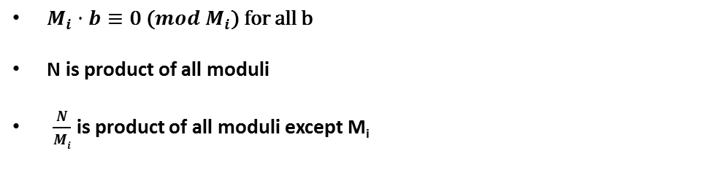
Make terms vanish for other moduli by multiplying by all other moduli
$M_{i}·b≡\text{0 (}mod M_{i}\text{) }\text{for} \text{all} \text{b}$
N is product of all moduli
$\frac{N}{Mi}$ is product of all moduli except M_{i}
INSERT
VIDEO
HERE

Slide 34
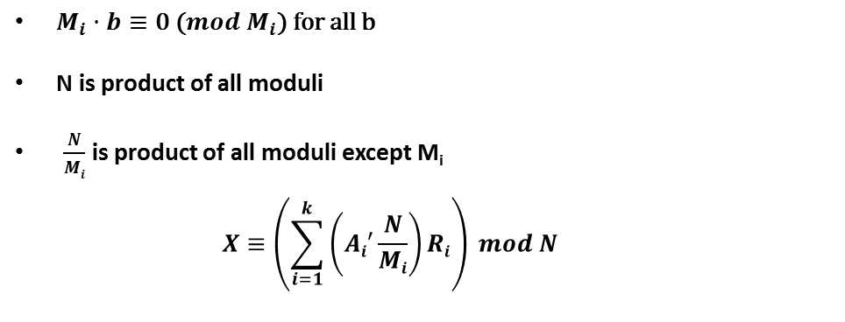
Make terms vanish for other moduli by multiplying by all other moduli
$M_{i}·b≡\text{0 (}mod M_{i}\text{) }\text{for} \text{all} \text{b}$
N is product of all moduli
$\frac{N}{Mi}$ is product of all moduli except M_{i}
$$X≡\left(\sum_{i=1}^{k}{\left(Ai′\frac{N}{Mi}\right)Ri}\right) mod N$$
INSERT
VIDEO
HERE

Slide 35
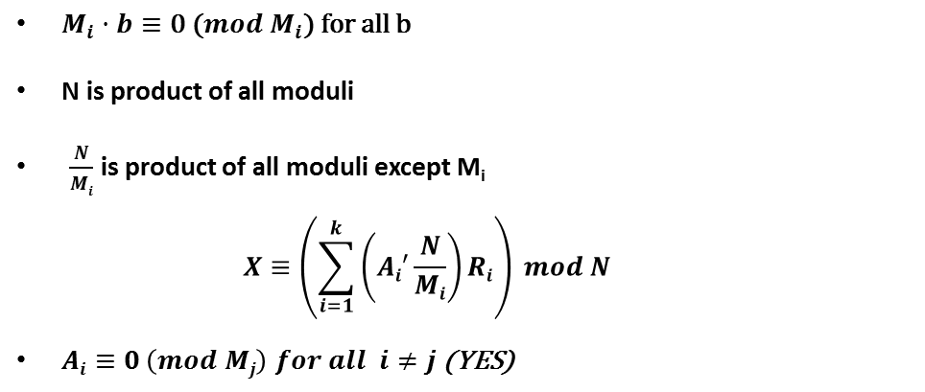
Make terms vanish for other moduli by multiplying by all other moduli
$M_{i}·b≡\text{0 (}mod M_{i}\text{) }\text{for} \text{all} \text{b}$
N is product of all moduli
$\frac{N}{Mi}$ is product of all moduli except M_{i}
$$X≡\left(\sum_{i=1}^{k}{\left(Ai′\frac{N}{Mi}\right)Ri}\right) mod N$$
$Ai≡0 \left(mod Mj\right) for all i≠j$ (YES)
INSERT
VIDEO
HERE

Slide 36
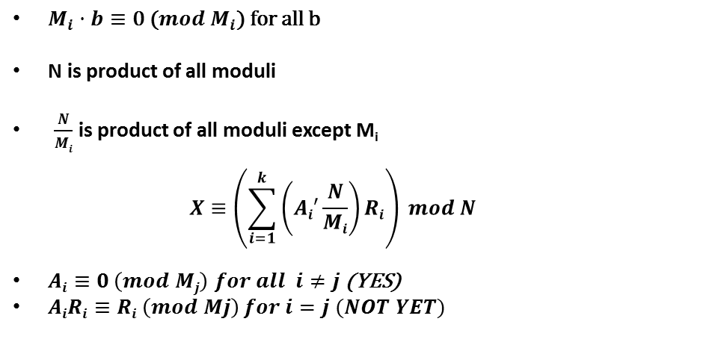
Make terms vanish for other moduli by multiplying by all other moduli
$M_{i}·b≡\text{0 (}mod M_{i}\text{) }\text{for} \text{all} \text{b}$
N is product of all moduli
$\frac{N}{Mi}$ is product of all moduli except M_{i}
$$X≡\left(\sum_{i=1}^{k}{\left(Ai′\frac{N}{Mi}\right)Ri}\right) mod N$$
$Ai≡0 \left(mod Mj\right) for all i≠j$ (YES)
$AiRi≡Ri \left(mod Mj\right) for i=j (NOT YET)$
INSERT
VIDEO
HERE

Slide 37
Multiply each coefficient by its multiplicative inverse for that term’s modulus
INSERT
VIDEO
HERE

Slide 38
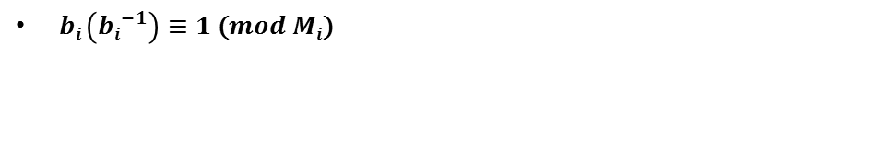
Multiply each coefficient by its multiplicative inverse for that term’s modulus
$bi \left({bi}^{−1}\right)≡1\text{ (}mod Mi\text{)}$
INSERT
VIDEO
HERE

Slide 39
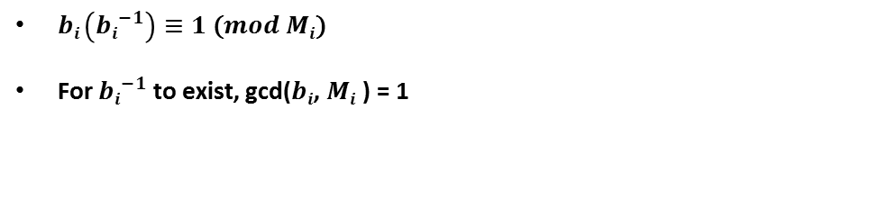
Multiply each coefficient by its multiplicative inverse for that term’s modulus
$bi \left({bi}^{−1}\right)≡1\text{ (}mod Mi\text{)}$
For ${bi}^{−1}$ to exist, gcd($bi$, $Mi$ ) = 1
INSERT
VIDEO
HERE

Slide 40
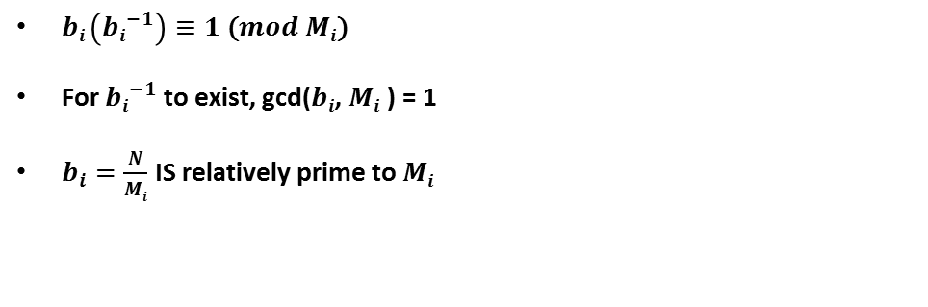
Multiply each coefficient by its multiplicative inverse for that term’s modulus
$bi \left({bi}^{−1}\right)≡1\text{ (}mod Mi\text{)}$
For ${bi}^{−1}$ to exist, gcd($bi$, $Mi$ ) = 1
$b_{i}=\frac{N}{Mi}$ IS relatively prime to $Mi$
INSERT
VIDEO
HERE

Slide 41
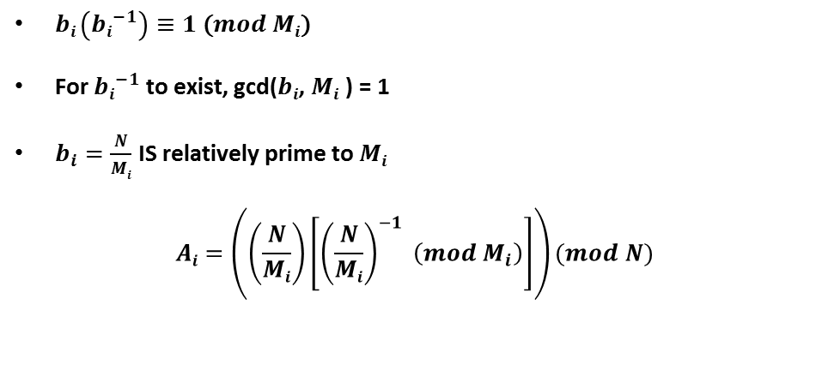
Multiply each coefficient by its multiplicative inverse for that term’s modulus
$bi \left({bi}^{−1}\right)≡1\text{ (}mod Mi\text{)}$
For ${bi}^{−1}$ to exist, gcd($bi$, $Mi$ ) = 1
$b_{i}=\frac{N}{Mi}$ IS relatively prime to $Mi$
$$Ai=\left(\left(\frac{N}{Mi}\right)\left[{\left(\frac{N}{Mi}\right)}^{−1} \left(mod M_{i}\right)\right]\right)(mod N)$$
INSERT
VIDEO
HERE

Slide 42
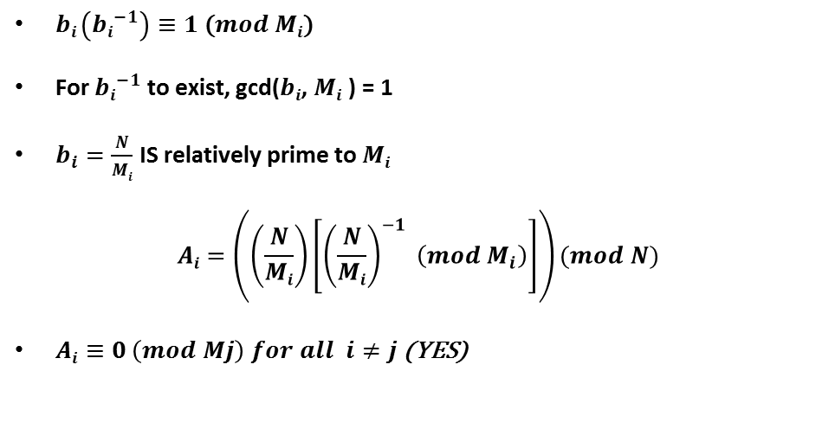
Multiply each coefficient by its multiplicative inverse for that term’s modulus
$bi \left({bi}^{−1}\right)≡1\text{ (}mod Mi\text{)}$
For ${bi}^{−1}$ to exist, gcd($bi$, $Mi$ ) = 1
$b_{i}=\frac{N}{Mi}$ IS relatively prime to $Mi$
$$Ai=\left(\left(\frac{N}{Mi}\right)\left[{\left(\frac{N}{Mi}\right)}^{−1} \left(mod M_{i}\right)\right]\right)(mod N)$$
$Ai≡0 \left(mod Mj\right) for all i≠j$ (YES)
INSERT
VIDEO
HERE

Slide 43
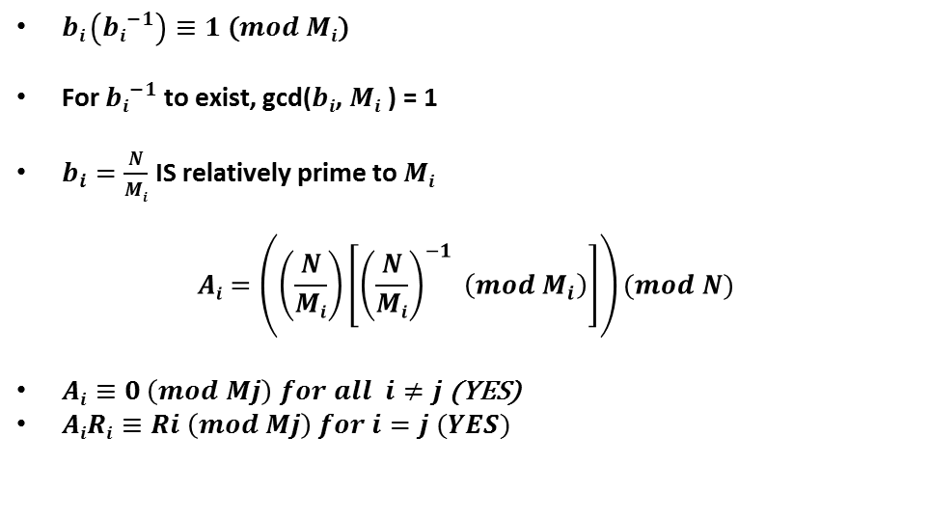
Multiply each coefficient by its multiplicative inverse for that term’s modulus
$bi \left({bi}^{−1}\right)≡1\text{ (}mod Mi\text{)}$
For ${bi}^{−1}$ to exist, gcd($bi$, $Mi$ ) = 1
$b_{i}=\frac{N}{Mi}$ IS relatively prime to $Mi$
$$Ai=\left(\left(\frac{N}{Mi}\right)\left[{\left(\frac{N}{Mi}\right)}^{−1} \left(mod M_{i}\right)\right]\right)(mod N)$$
$Ai≡0 \left(mod Mj\right) for all i≠j$ (YES)
$AiRi≡Ri \left(mod Mj\right) for i=j (YES)$
INSERT
VIDEO
HERE

Slide 44
Everything CRT in one place
INSERT
VIDEO
HERE

Slide 45

Everything CRT in one place
$$N=\prod_{i=1}^{k}{M_{i}}; R_{i}=X mod N$$
INSERT
VIDEO
HERE

Slide 46

Everything CRT in one place
$$N=\prod_{i=1}^{k}{M_{i}}; R_{i}=X mod N$$
$$X≡\left(\sum_{i=1}^{k}{AiRi}\right) mod N$$
INSERT
VIDEO
HERE

Slide 47

Everything CRT in one place
$$N=\prod_{i=1}^{k}{M_{i}}; R_{i}=X mod N$$
$$X≡\left(\sum_{i=1}^{k}{AiRi}\right) mod N$$
$$Ai=\left(\left(\frac{N}{Mi}\right)\left[{\left(\frac{N}{Mi}\right)}^{−1} \left(mod M_{i}\right)\right]\right)(mod N)$$
INSERT
VIDEO
HERE

Slide 48
What is (2, 7, 19) (mod (4, 9, 25))?
INSERT
VIDEO
HERE

Slide 49
What is (2, 7, 19) (mod (4, 9, 25))?
$N=4·9·25=900$
INSERT
VIDEO
HERE

Slide 50
What is (2, 7, 19) (mod (4, 9, 25))?
$N=4·9·25=900$
$M_{1}=4$
INSERT
VIDEO
HERE

Slide 51
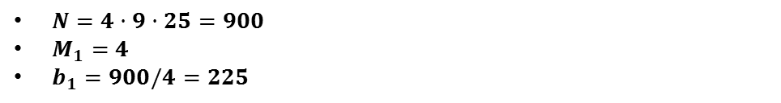
What is (2, 7, 19) (mod (4, 9, 25))?
$N=4·9·25=900$
$M_{1}=4$
$b_{1}=900/4=225$
INSERT
VIDEO
HERE

Slide 52
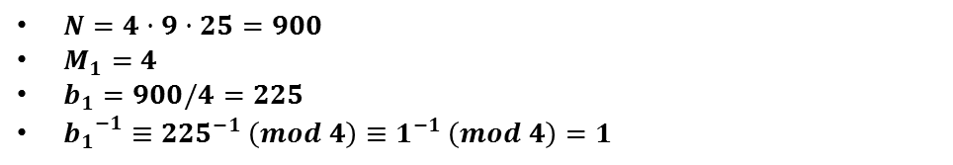
What is (2, 7, 19) (mod (4, 9, 25))?
$N=4·9·25=900$
$M_{1}=4$
$b_{1}=900/4=225$
${b_{1}}_{}^{−1}≡{225}^{−1} \left(mod 4\right)≡1^{−1} \left(mod 4\right)=1$
INSERT
VIDEO
HERE

Slide 53
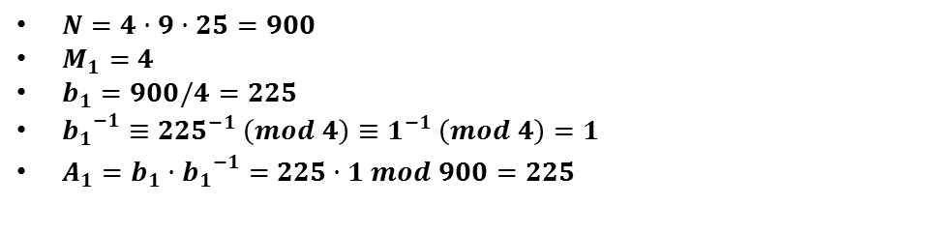
What is (2, 7, 19) (mod (4, 9, 25))?
$N=4·9·25=900$
$M_{1}=4$
$b_{1}=900/4=225$
${b_{1}}_{}^{−1}≡{225}^{−1} \left(mod 4\right)≡1^{−1} \left(mod 4\right)=1$
$A_{1}={b_{1}·b_{1}}_{}^{−1}=$ $225·1 mod 900=225$
INSERT
VIDEO
HERE

Slide 54
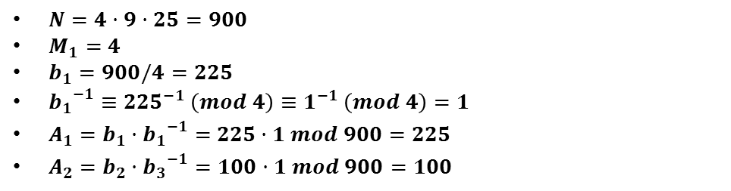
What is (2, 7, 19) (mod (4, 9, 25))?
$N=4·9·25=900$
$M_{1}=4$
$b_{1}=900/4=225$
${b_{1}}_{}^{−1}≡{225}^{−1} \left(mod 4\right)≡1^{−1} \left(mod 4\right)=1$
$A_{1}={b_{1}·b_{1}}_{}^{−1}=$ $225·1 mod 900=225$
$A_{2}={b_{2}·b_{3}}_{}^{−1}=100·1 mod 900=100$
INSERT
VIDEO
HERE

Slide 55
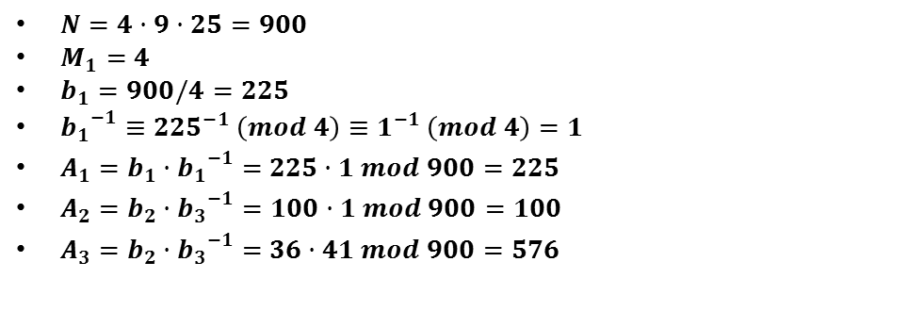
What is (2, 7, 19) (mod (4, 9, 25))?
$N=4·9·25=900$
$M_{1}=4$
$b_{1}=900/4=225$
${b_{1}}_{}^{−1}≡{225}^{−1} \left(mod 4\right)≡1^{−1} \left(mod 4\right)=1$
$A_{1}={b_{1}·b_{1}}_{}^{−1}=$ $225·1 mod 900=225$
$A_{2}={b_{2}·b_{3}}_{}^{−1}=100·1 mod 900=100$
$A_{3}={b_{2}·b_{3}}_{}^{−1}=$ $36·41 mod 900=576$
INSERT
VIDEO
HERE

Slide 56
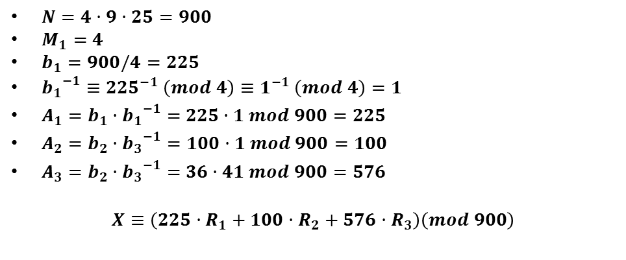
What is (2, 7, 19) (mod (4, 9, 25))?
$N=4·9·25=900$
$M_{1}=4$
$b_{1}=900/4=225$
${b_{1}}_{}^{−1}≡{225}^{−1} \left(mod 4\right)≡1^{−1} \left(mod 4\right)=1$
$A_{1}={b_{1}·b_{1}}_{}^{−1}=$ $225·1 mod 900=225$
$A_{2}={b_{2}·b_{3}}_{}^{−1}=100·1 mod 900=100$
$A_{3}={b_{2}·b_{3}}_{}^{−1}=$ $36·41 mod 900=576$
$$X≡\left(225·R_{1}+100·R_{2}+576·R_{3}\right)\left(mod 900\right)$$
INSERT
VIDEO
HERE

Slide 57
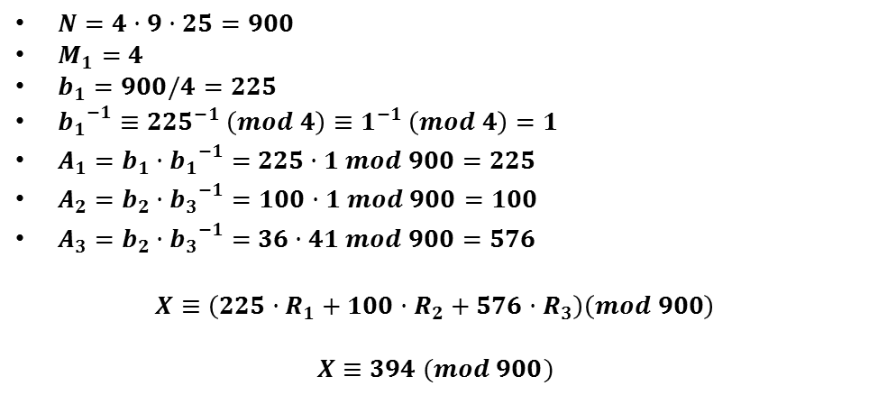
What is (2, 7, 19) (mod (4, 9, 25))?
$N=4·9·25=900$
$M_{1}=4$
$b_{1}=900/4=225$
${b_{1}}_{}^{−1}≡{225}^{−1} \left(mod 4\right)≡1^{−1} \left(mod 4\right)=1$
$A_{1}={b_{1}·b_{1}}_{}^{−1}=$ $225·1 mod 900=225$
$A_{2}={b_{2}·b_{3}}_{}^{−1}=100·1 mod 900=100$
$A_{3}={b_{2}·b_{3}}_{}^{−1}=$ $36·41 mod 900=576$
$$X≡\left(225·R_{1}+100·R_{2}+576·R_{3}\right)\left(mod 900\right)$$
$$X≡394 (mod 900)$$
INSERT
VIDEO
HERE

